Slide 1
Azure Cosmos DB

Slide 2
History
2015-azure document db
2017 rebrand as CosmosDB

Slide 3
Features
Fully managed no sql, Relational DB
Distributed Database-Multi Region data distribution
Single Digit Millisecond response time
Guranteed speed at any scale
Serverless architecture
Highle Scalable
Unlimited scale for both storage and compute
No Operation Overhead and No shcema Index
Business Continuity with high sla of 99.999% @ 10 Ms latency
Enterprise Grade Security

Slide 4
Cont…
Low Latency and High Availability
Open Source Api
SDK for popular language
Capacity management
Azure synapse link for azure cosmos DB
Different Consistent level like strong eventually, consisten prefix,session bound staleness supported

Slide 5
API in Cosmos DB
No SQL MongoDb PostgreSQL Apache Casandra Apache Gramlin Table
Model real world data
Less management highly scalable
Use ecosystem tools and skill
All the api offer Automatica scaling Flexibility and Performance gurantees
There no one best APi

Slide 6
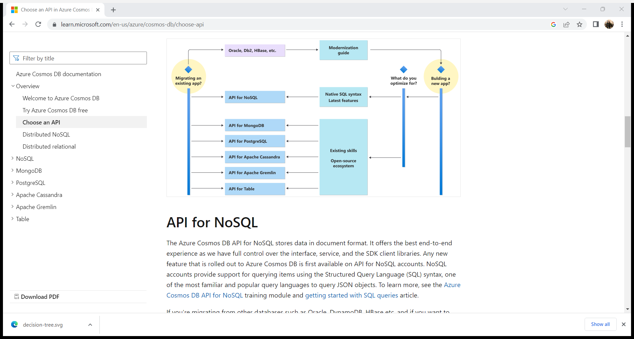
How to Chosse Cosmos DB API

Slide 7
Why No SQL Database
Need of Modern App
High Volume of data
Data with different source and forms
Dynamic data schemas
High velocity and real time data
Common characteristics
Data store is non relational
Design for scale out
Do not enforce a specific schema
Horizontal scalable

Slide 8
NO SQL Data Model
In general, there are four different types of data models in NoSQL. They are as follows and we will discuss them one by one.
Key value Store
Document based
Column based
Graph based

Slide 9
1. Key-value Store
As the name suggests the Key-value store simply uses the key value to store data in the database. The key in the key-value pair must be unique. The rules set for what the key can be the length for the size of the key depends on the database to the database. For example in Redis, the maximum size for Key is 512mb. Even the empty string is a valid key.
The size of the key is important here as a long key can cause performance issues whereas a too short a key can cause readability issues. The value in the key-value pair can be anything from a String to an image. You can also specify the data type of the value here.

Slide 10
2. Document-Based Store NoSQL
In this type of database, the record and its associated data are stored in a single document. So this model is not completely unstructured but it is a kind of Semi-structured data.
The difference between a document and Key value pair is that in document type storage is that in this type some kind of encoding is provided while storing the data in documents, It can be XML encoding or JSON encoding.
The below example shows a document that can be stored in a document database but with a different encoding. Let’s look at the XML example.

Slide 11
3. Column Based Store
In this type of database, the focus is on columns rather than rows as data is stored in columns instead of rows which is the case with most relational databases. Since data is stored in cells grouped in columns so all read-write is done using columns, not rows.
The interesting question arises is that why use columns rather than rows? The answer to this question is that when you store data in columns you can do a fast search and fast retrieval and aggregation because it stores all the cells of a column as a continuous entry which then allows faster access.
As an example, if we want to query titles from million articles, it will be easy to get in the column-based data model as with one disk entry we will get the titles of the article easily whereas in relational databases it has to get over to each location to get the titles. Examples of Column based store databases is HBase, Big Table, Cassandra.

Slide 12
4. Graph-Based Store
As the name suggests graphical representation is used instead of tables or columns representation. The important feature of this type of data model is the presence of nodes and edges. The two nodes, for example, are connected with some relationships and the relationship here is represented by edges.
Also, you can efficiently transform data from one model to another using this Graph-based NoSQL data model. There are two commonly used graph-based databases which are InfoGrid and Infinite Graph. InfoGrid also offers two kinds of graph databases like MeshBase and NetMeshbase which users can choose depends on the requirements of the user.

Slide 13
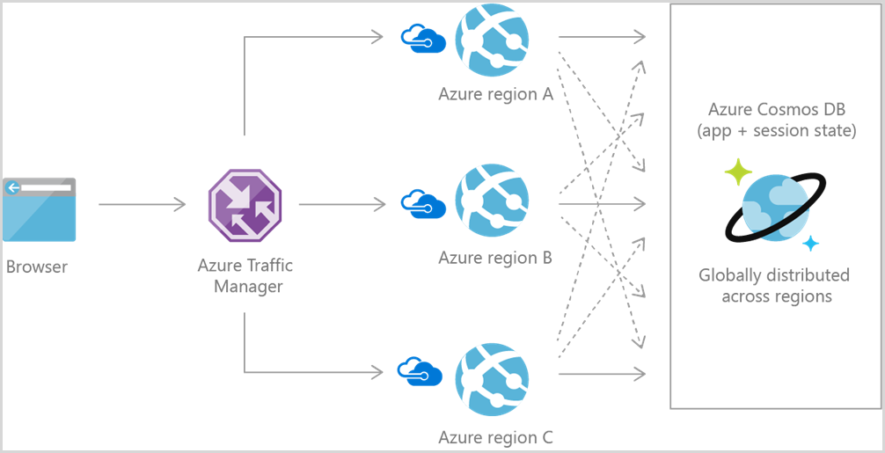
What is Azure cosmos DB for No SQL
Fast database rich query over diverse data
Configurable reliable performance globally distributed
Repid development
Core of native Api for working with documents

Slide 14
Advantage of cosmos db
Guranteed Speed at any Scale
Fast Flexible for app development
Ready for mission critical application

Slide 15
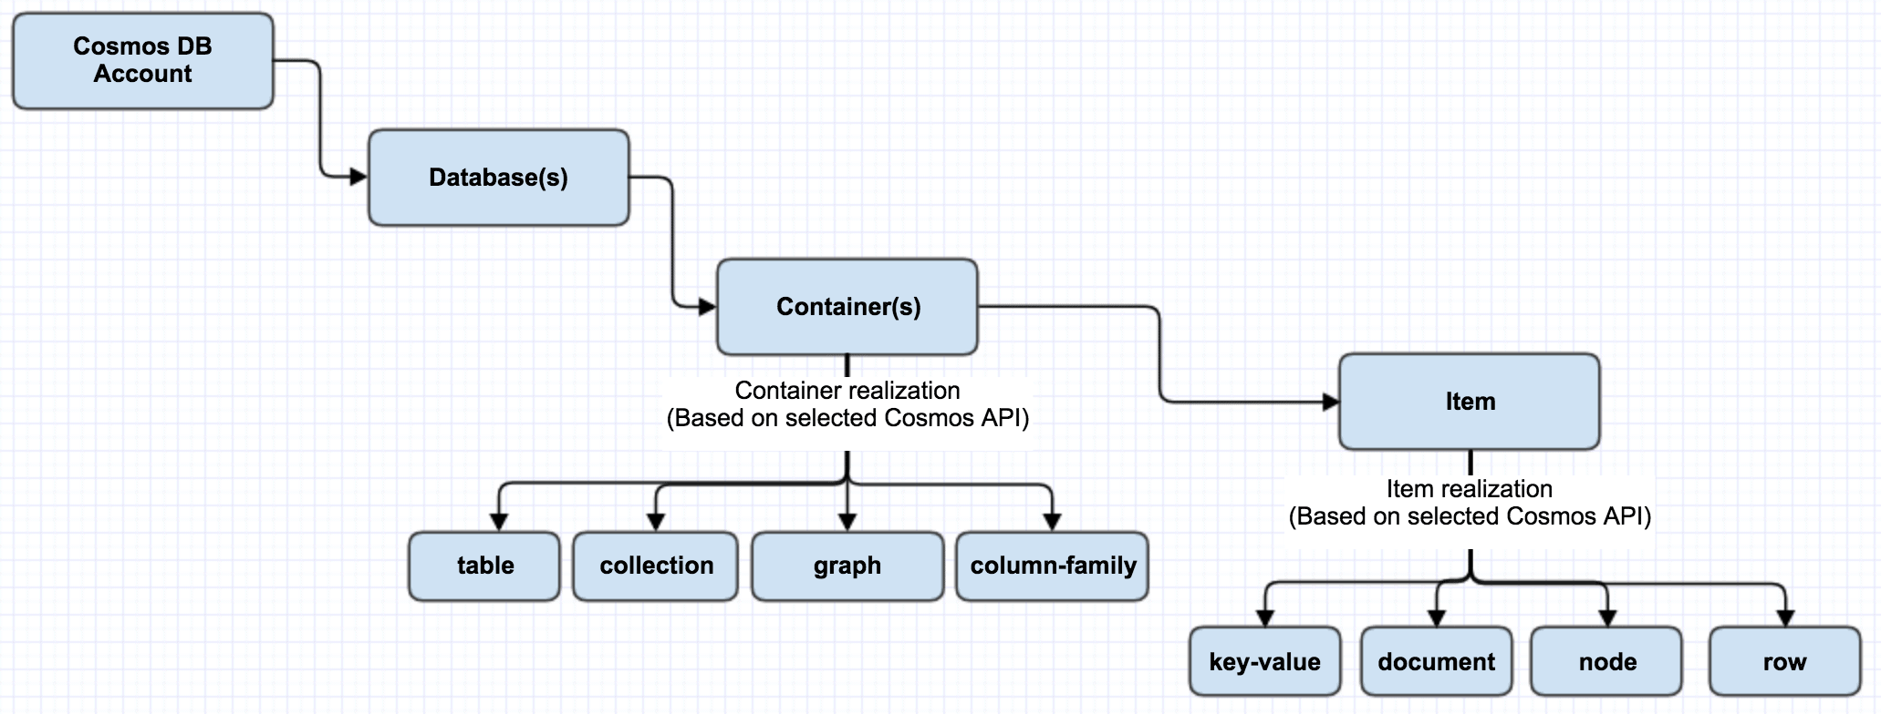
Azure Cosmos DB component

Slide 16
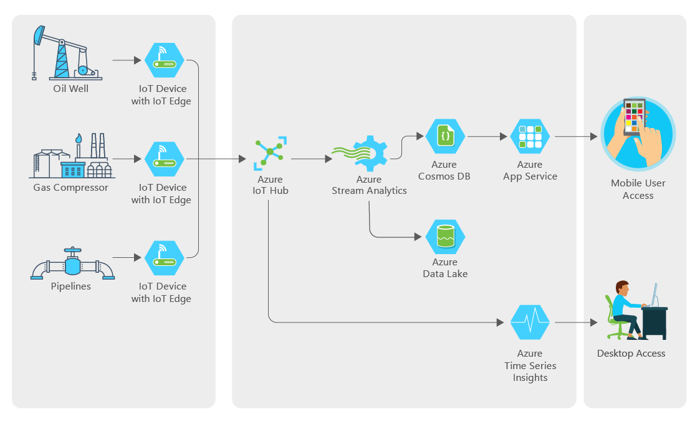
Use case IOT

Slide 17
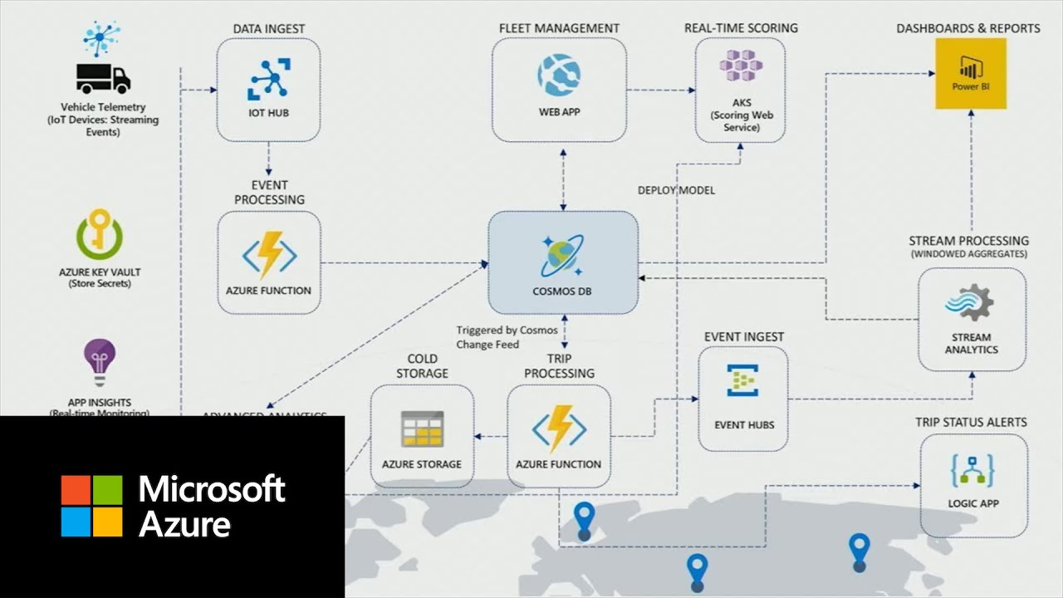
Retails

Slide 18
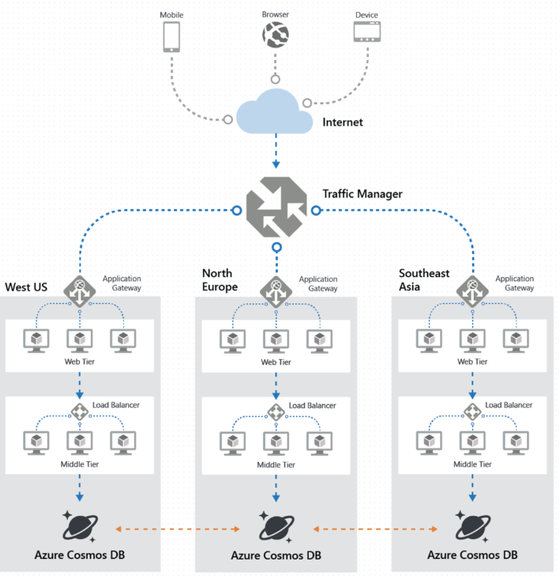
Mobile

Slide 19
What are the component of Azure Cosmos DB
Account: Fundamental unit of dis

Slide 20

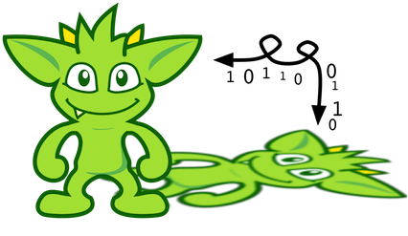
Gremlins

Slide 21
Gremline
Azure Cosmos DB for Apache Gremlin is a graph database service that can be used to store massive graphs with billions of vertices and edges. You can query the graphs with millisecond latency and evolve the graph structure easily. The API for Gremlin is built based on Apache TinkerPop, a graph computing framework that uses the Gremlin query languag

Slide 22
The API for Gremlin combines the power of graph database algorithms with highly scalable, managed infrastructure. This approach provides a unique and flexible solution to common data problems associated with inflexible or relational constraints.

Slide 23
API for Gremlin benefits
Elastically scalable throughput and storage: Graphs in the real world need to scale beyond the capacity of a single server. Azure Cosmos DB supports horizontally scalable graph databases that can have an unlimited size in terms of storage and provisioned throughput. As the graph database scale grows, the data will be automatically distributed using graph partitioning.
Multi-region replication: Azure Cosmos DB can automatically replicate your graph data to any Azure region worldwide. Global replication simplifies the development of applications that require global access to data. In addition to minimizing read and write latency anywhere around the world, Azure Cosmos DB provides automatic regional failover mechanism. This mechanism can ensure the continuity of your application in the rare case of a service interruption in a region.

Slide 24
Fast queries and traversals with the most widely adopted graph query standard: Store heterogeneous vertices and edges and query them through a familiar Gremlin syntax. Gremlin is an imperative, functional query language that provides a rich interface to implement common graph algorithms. The API for Gremlin enables rich real-time queries and traversals without the need to specify schema hints, secondary indexes, or views. For more information, see query graphs by using Gremlin.
Compatibility with Apache TinkerPop: The API for Gremlin supports the open-source Apache TinkerPop standard. The Apache TinkerPop standard has an ample ecosystem of applications and libraries that can be easily integrated with the API.
Tunable consistency levels: Azure Cosmos DB provides five well-defined consistency levels to achieve the right tradeoff between consistency and performance for your application. For queries and read operations, Azure Cosmos DB offers five distinct consistency levels: strong, bounded-staleness, session, consistent prefix, and eventual. These granular, well-defined consistency levels allow you to make sound tradeoffs among consistency, availability, and latency. For more information, see tunable data consistency levels in Azure Cosmos DB.

Slide 25
Use Case
Social networks/Customer 365: By combining data about your customers and their interactions with other people, you can develop personalized experiences, predict customer behavior, or connect people with others with similar interests. Azure Cosmos DB can be used to manage social networks and track customer preferences and data.
Recommendation engines: This scenario is commonly used in the retail industry. By combining information about products, users, and user interactions, like purchasing, browsing, or rating an item, you can build customized recommendations. The low latency, elastic scale, and native graph support of Azure Cosmos DB is ideal for these scenarios.

Slide 26
Geospatial: Many applications in telecommunications, logistics, and travel planning need to find a location of interest within an area or locate the shortest/optimal route between two locations. Azure Cosmos DB is a natural fit for these problems.
ternet of Things: With the network and connections between IoT devices modeled as a graph, you can build a better understanding of the state of your devices and assets. You also can learn how changes in one part of the network can potentially affect another part.

Slide 27
Introduction to graph databases
Data as it appears in the real world is naturally connected. Traditional data modeling focuses on defining entities separately and computing their relationships at runtime. While this model has its advantages, highly connected data can be challenging to manage under its constraints.
A graph database approach relies on persisting relationships in the storage layer instead, which leads to highly efficient graph retrieval operations. The API for Gremlin supports the property graph model.

Slide 28
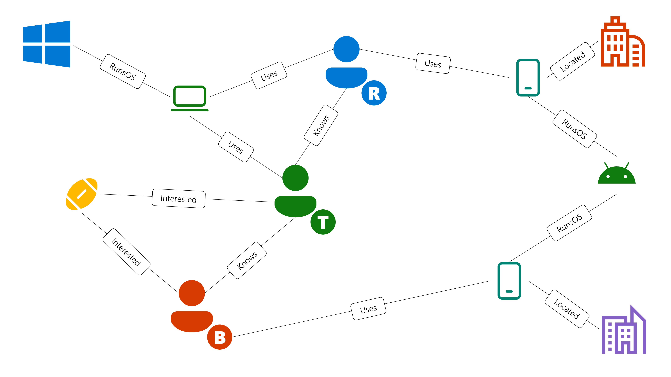

Slide 29
This graph has the following vertex types. These types are also called labels in Gremlin:
People: The graph has three people; Robin, Thomas, and Ben.
Interests: Their interests, in this example, include the game of Football.
Devices: The devices that people use.
Operating Systems: The operating systems that the devices run on.
Place: The places from which the devices are accessed.
We represent the relationships between these entities via the following edge types:
Knows: Represent familiarity. For example, "Thomas knows Robin".
Interested: Represent the interests of the people in our graph. For example, "Ben is interested in Football".
RunsOS: Represent what OS a device runs. For example, "Laptop runs the Windows OS".
Uses: Represent which device a person uses. For example, "Robin uses a Motorola phone with serial number 77".
Located: Represent the location from which the devices are accessed.

